Slide 1
ACADEMY NEXUS
College Management System in Python Django
Suvarna Dhavale (2261920) Shruti mergu (2202829)

Slide 2
1: Introduction
The ACADEMY NEXUS is a modern solution created with Python and Django to improve how colleges manage their administrative tasks. It offers a range of features to make managing things like student enrollment, attendance, and results easier and more efficient. By automating these tasks, the system reduces manual work, cuts down on errors, and boosts overall efficiency. It also enhances communication and collaboration among students, staff, and administrators, creating a more productive learning environment. The system can handle various needs, such as managing student records, scheduling courses, and organizing exams, and is flexible enough to adapt to future changes.

Slide 3
2: Importance of ACADEMY NEXUS
Centralized Data Management
Enhanced Communication
Improved Accuracy
(Importance of college management systems)
User-Friendly Interface
Real-Time Information Access

Slide 4



3: Existing System
1. Different software
2. Paper-Based Systems
3. physically present

Slide 5
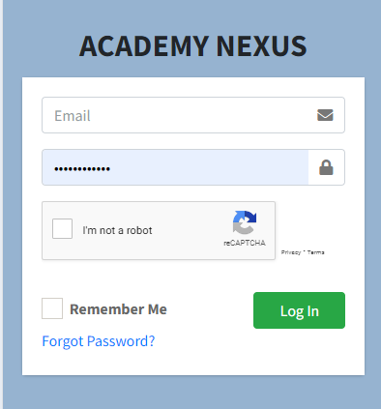
4: System Features Overview
Login Page

Slide 6
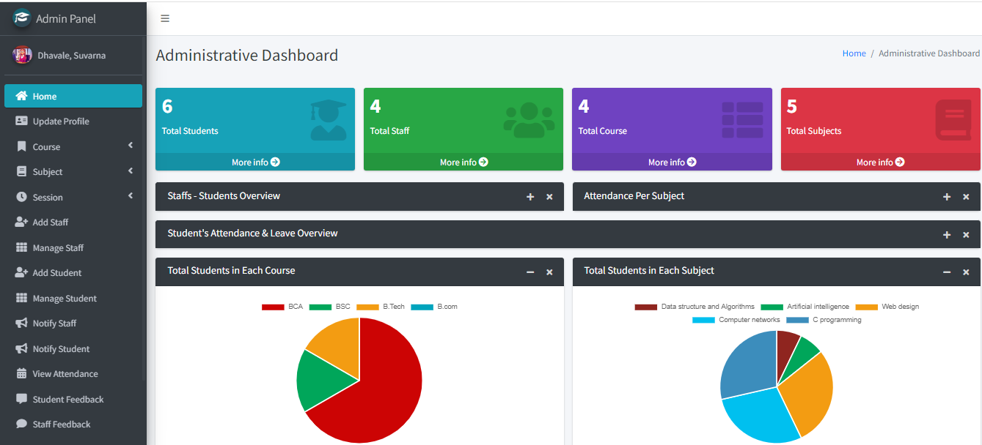
Admin Panel

Slide 7
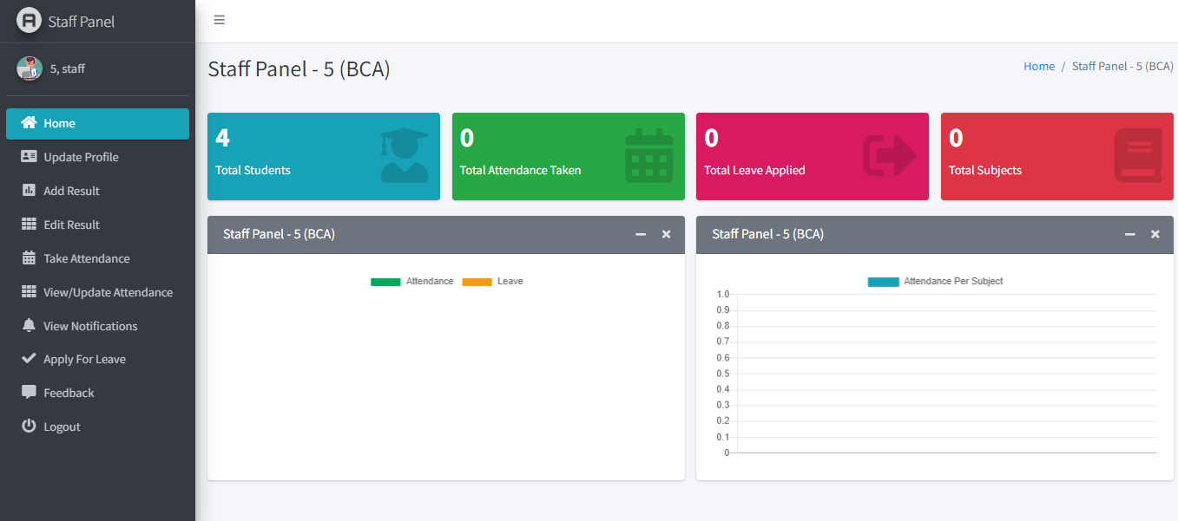
Staff Panel Screens

Slide 8
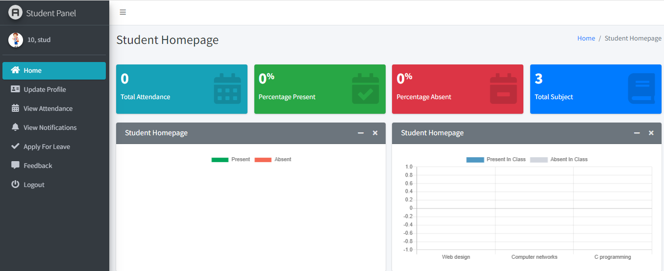
Student Panel Screens

Slide 9
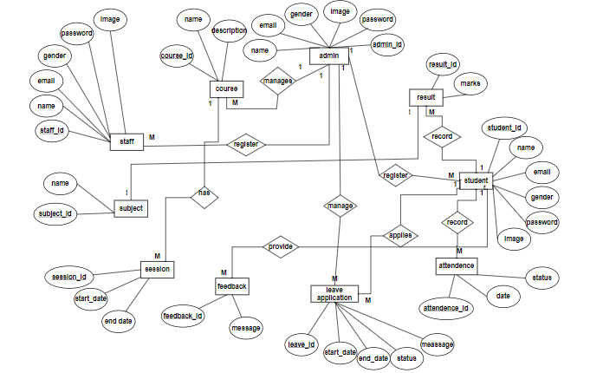
5: Diagrams
ER Diagram

Slide 10
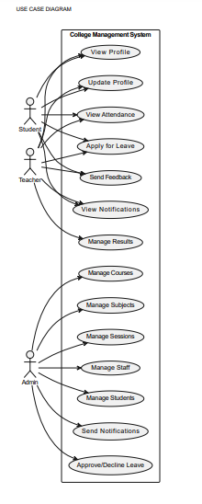
Use Case Diagrams

Slide 11
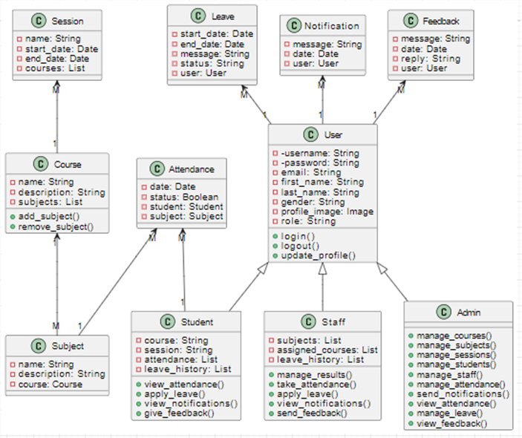
Class Diagrams

Slide 12
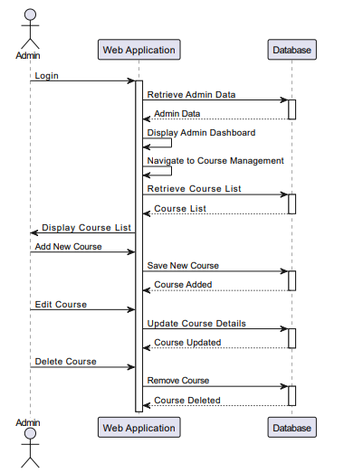
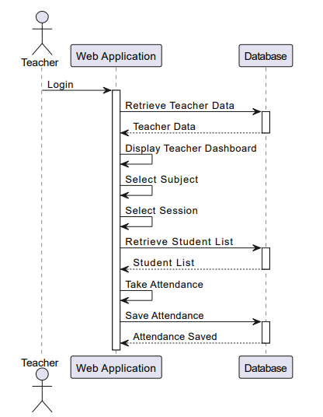
Sequence Diagrams
Admin
Teacher

Slide 13
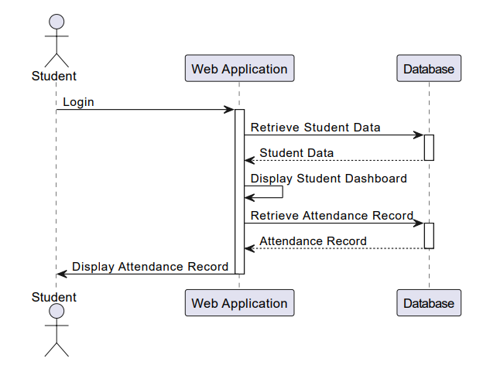
Student

Slide 14
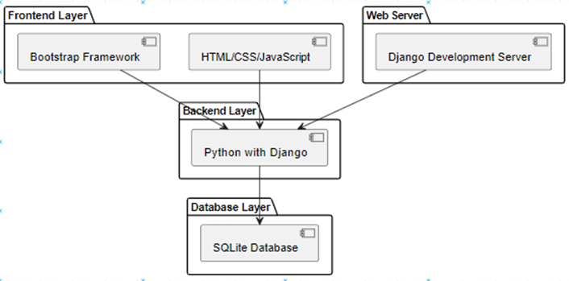
System Architecture

Slide 15
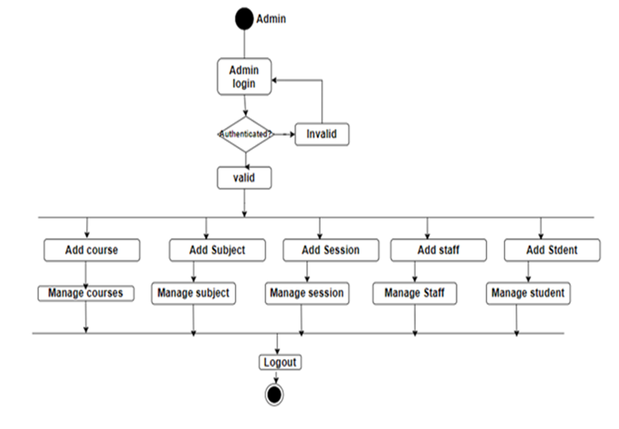
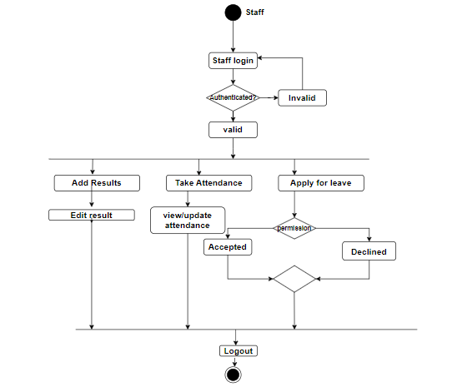
Activity Diagram
Admin
Staff

Slide 16
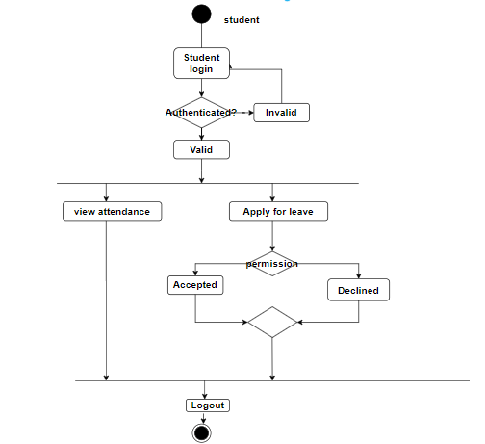
Student

Slide 17
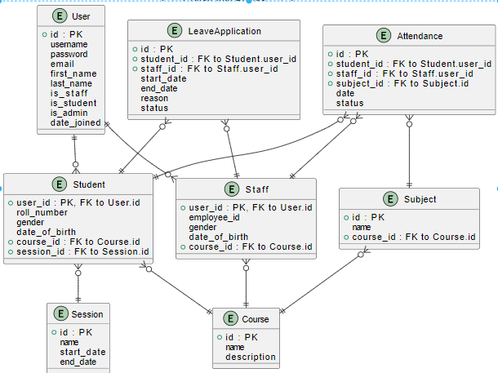
Database Schema

Slide 18
Limitations
Scalability Issues
Security Concerns
Limited Customization
Mobile Compatibility

Slide 19
Future Enhancements
Database Upgrade
Enhanced Security
Customization Options
Mobile Optimization

Slide 20
Conclusion
ACADEMY NEXUS built with Django helps schools manage student and teacher info, attendance, and alerts. It's like a user-friendly app with separate sections for students, teachers, and principals. Even though it's not perfect, it's a great way to organize things digitally at schools!

Slide 21
Thank you !!

